Slide 2
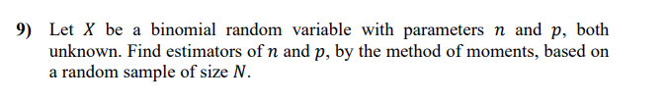
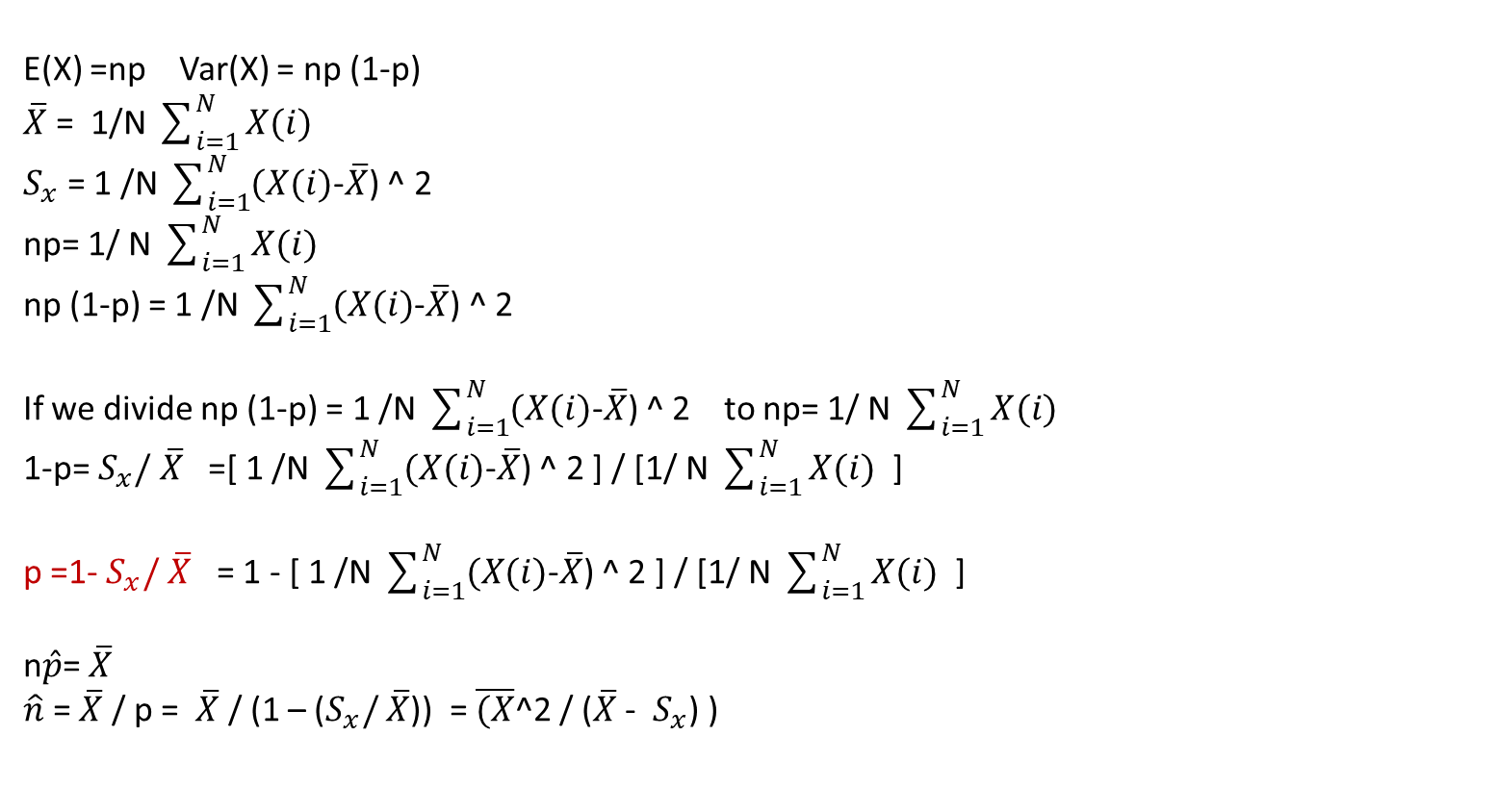
E(X) =np Var(X) = np (1-p)
$\overline{X}$ = 1/N $\sum_{i=1}^{N}{X(i)}$
$S_{x}$ = 1 /N $\sum_{i=1}^{N}{(X(i)}$-$\overline{X}$) ^ 2
np= 1/ N $\sum_{i=1}^{N}{X(i)}$
np (1-p) = 1 /N $\sum_{i=1}^{N}{(X(i)}$-$\overline{X}$) ^ 2
If we divide np (1-p) = 1 /N $\sum_{i=1}^{N}{(X(i)}$-$\overline{X}$) ^ 2 to np= 1/ N $\sum_{i=1}^{N}{X(i)}$
1-p= $S_{x}/$ $\overline{X}$ =[ 1 /N $\sum_{i=1}^{N}{(X(i)}$-$\overline{X}$) ^ 2 ] / [1/ N $\sum_{i=1}^{N}{X(i)}$ ]
p =1- $S_{x}/$ $\overline{X}$ = 1 - [ 1 /N $\sum_{i=1}^{N}{(X(i)}$-$\overline{X}$) ^ 2 ] / [1/ N $\sum_{i=1}^{N}{X(i)}$ ]
n$\hat{p}$= $\overline{X}$
$\hat{n}$ = $\overline{X}$ / p = $\overline{X}$ / (1 – ($S_{x}/$ $\overline{X}$)) = $\overline{(X}$^2 / ($\overline{X}$ - $S_{x}$) )

Slide 3
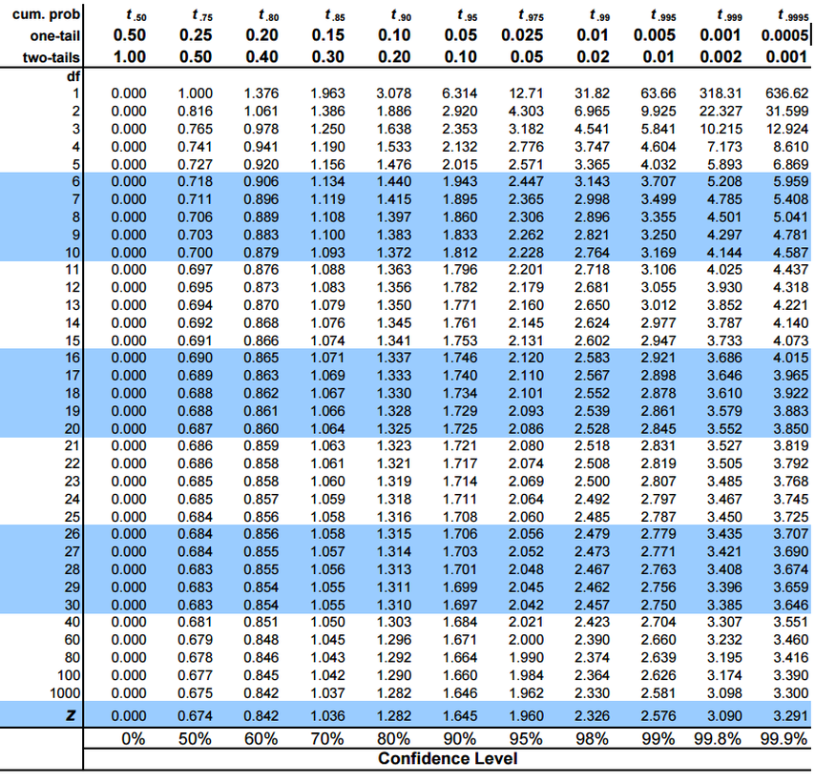

Slide 4
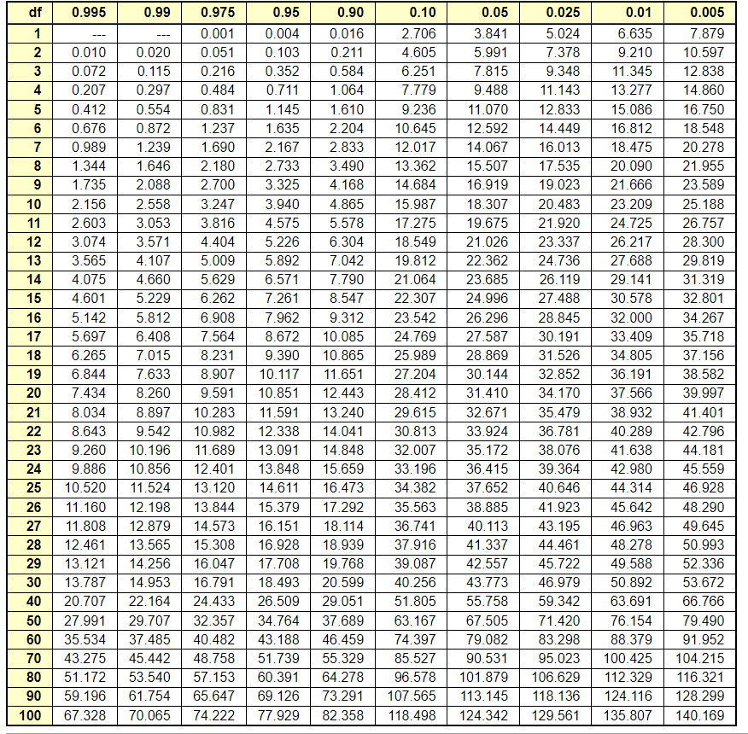

Slide 5
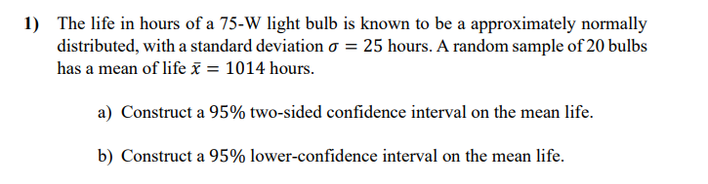


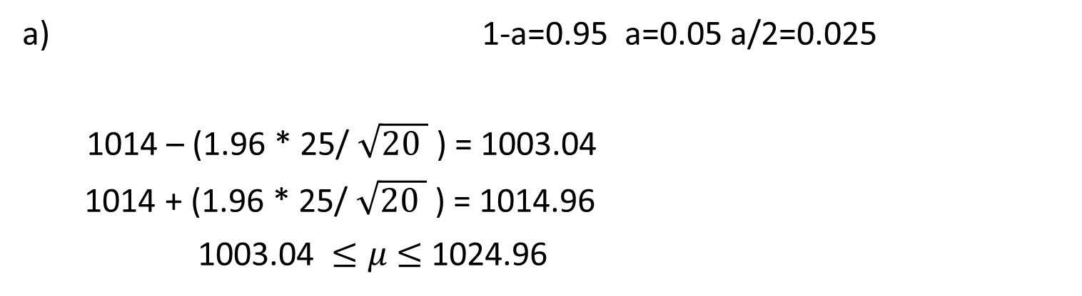
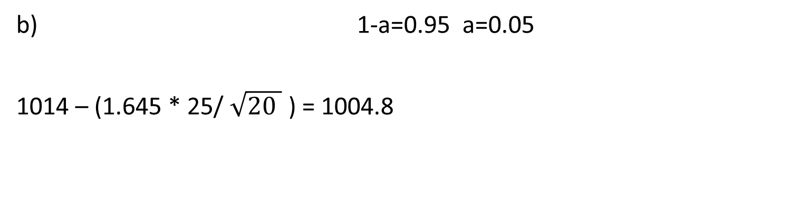
a) 1-a=0.95 a=0.05 a/2=0.025
1014 – (1.96 * 25/ $\sqrt{20 }$ ) = 1003.04
1014 + (1.96 * 25/ $\sqrt{20 }$ ) = 1014.96
1003.04 $≤μ$ $≤$ 1024.96
b) 1-a=0.95 a=0.05
1014 – (1.645 * 25/ $\sqrt{20 }$ ) = 1004.8

Slide 6


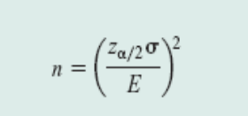
n= ( 1.96 * 25 /5 )^2 = 96.04 97

Slide 7
If total width = 8, therefore half width E= 4
n= ( 1.96 * 25 /4 )^2 =150.06 150 or 151

Slide 8
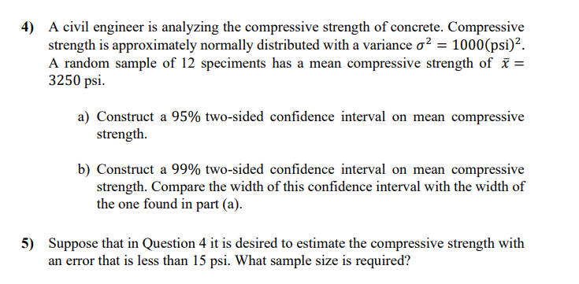
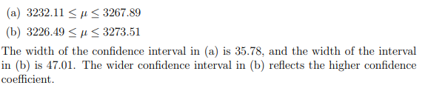

Answers:
5)

Slide 9
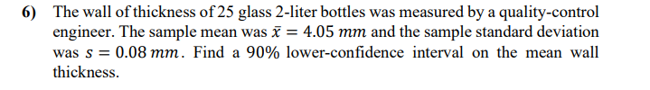

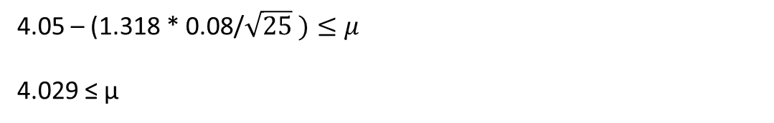
4.05 – (1.318 * 0.08/$\sqrt{25} )≤μ$
4.029 ≤ µ

Slide 10
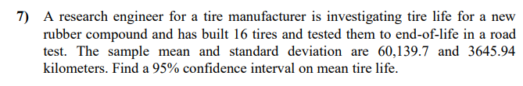


60139.7 $±$ 1942.37 ( 2.131 * 3645.94 / $\sqrt{16}$ )
58197.33 $≤μ$ $≤ 62082.07$

Slide 11
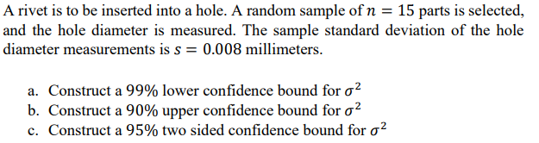
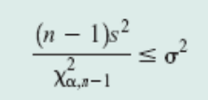
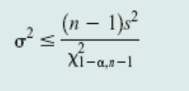
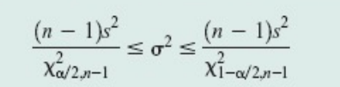
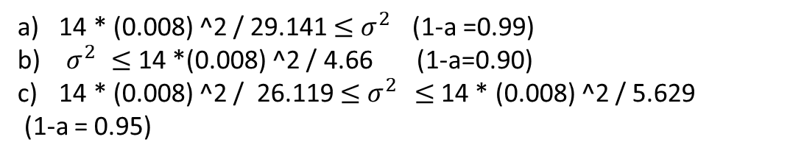
14 * (0.008) ^2 / 29.141 $≤$ $σ^{2 }$(1-a =0.99)
b) $σ^{2 }$ $≤$ 14 *(0.008) ^2 / 4.66 (1-a=0.90)
14 * (0.008) ^2 / 26.119 $≤$ $σ^{2 }≤$14 * (0.008) ^2 / 5.629
(1-a = 0.95)

